Slide 1

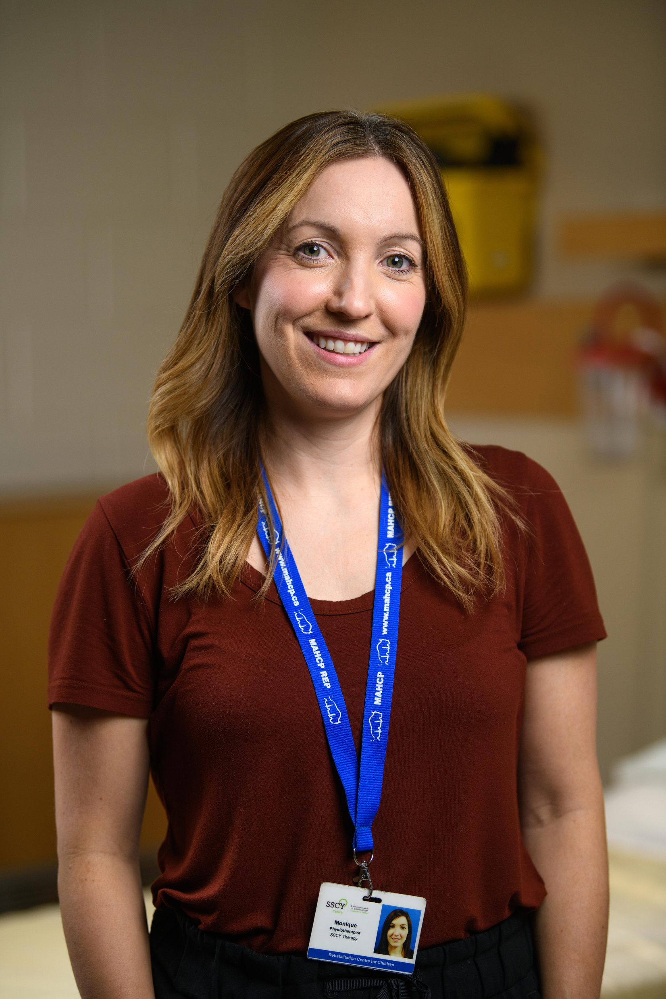
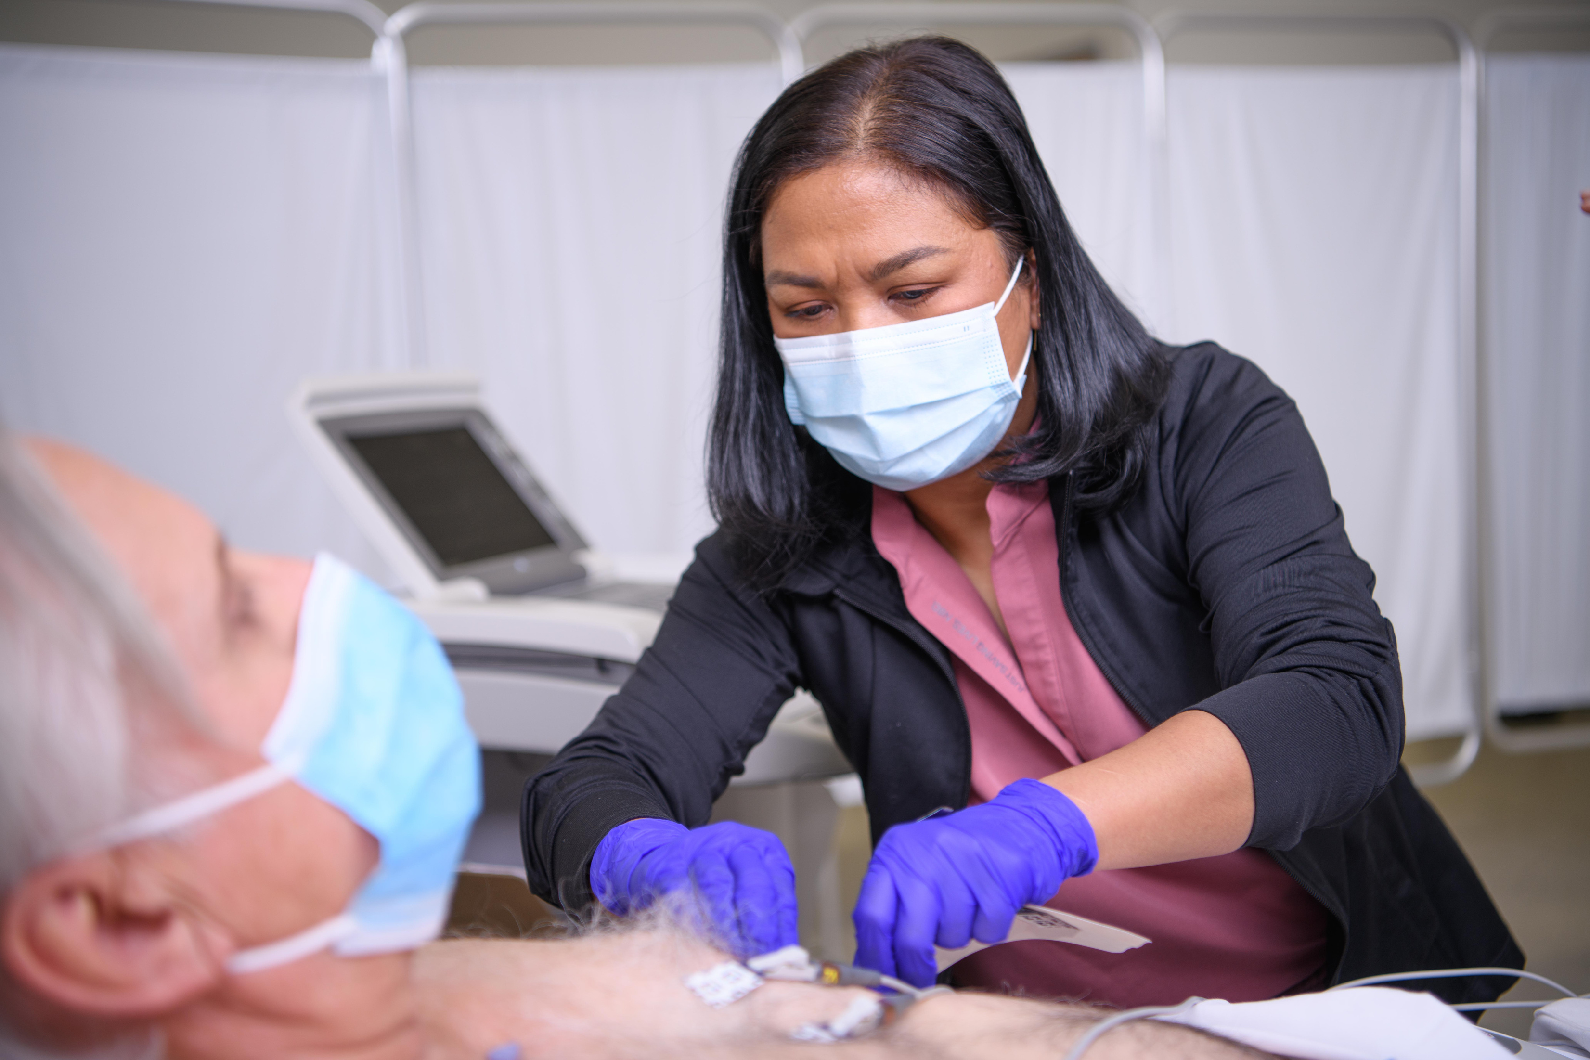


WELCOME TO MAHCP
New member orientation

Slide 2










OUR MEMBERSHIP
MAHCP represents 85% of all allied health professionals in Manitoba’s public health-care system.
7,000+ specialized, highly-educated members in 45 professions, 200 classifications
Professional, technical and paramedical working in prevention, emergency response, diagnostics, assessment, treatment, recovery & rehabilitation
Employed across Manitoba in hospitals, labs, clinics, long-term care, community

Slide 3

OUR UNION
Only union in Manitoba solely dedicated to professional/technical and paramedical
More than 50 years of experience representing health-care professionals
Direct service model
Labour Relations Officers (LRO) – your first point of contact for support
Onsite, volunteer Member Advocates
Governed by an elected Executive Council; representatives from 16 districts across Manitoba

Slide 4





HOW WE SUPPORT YOU
Negotiating for better wages and benefits, improved working conditions
Strong collective bargaining: fighting for fair pay and contract enhancements
Knowledgeable representation & advocacy: speaking out on your behalf, championing workplace concerns and emerging issues
Saving you $: Exclusive discounts for members, professional development fund/scholarships
Keeping you informed: Union news, member features, bargaining updates, regular emails

Slide 5
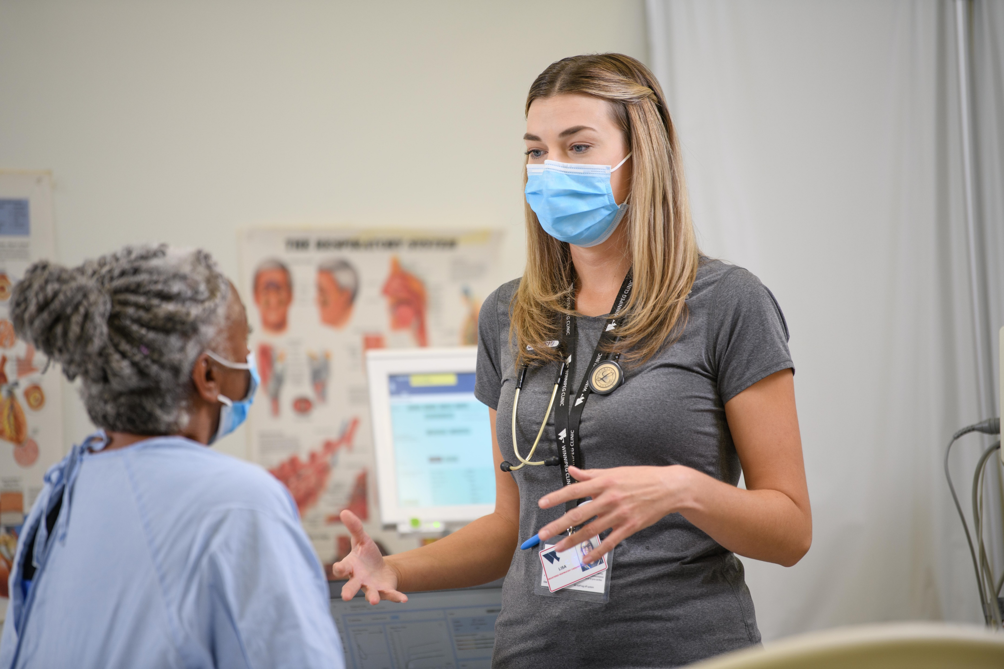
WHY MAHCP
Lowest member-to-LRO ratio of any competitor union in Manitoba
In-house legal counsel with extensive experience in policy and individual grievance filing and arbitration
One Member One Vote – AGMs are not delegated, any member can attend and have a voice
Board comprised entirely of health-care professionals
First union to secure maternity leave top-up benefit for members
Service mobility agreements between bargaining units and regions

Slide 6

ADVOCACY
Workplace Health & Safety Committees
Employee Management Advisory Committees: employer/union collaboration to address emerging issues
Ongoing member mobilization and government relations to strengthen allied health professions for the future

Slide 7

INVESTMENT & BENEFITS
1.25% of your gross earnings, automatically deducted from your pay
Your dues support collective bargaining, representation for you and your colleagues, grievance filing & investigation, legal research, arbitration
Members in Good Standing may:
Speak & vote at the AGM
Participate in ratification votes
Hold elective office
Volunteer for committees

Slide 8

PROFESSIONAL
DEVELOPMENT
Continuing education for members
Up to three (3) $1,500 scholarships/yr open to MAHCP members in good standing to upgrade
Scholarships
Up to three (3) $500 scholarships/yr for Manitoba residents entering 1st year training in allied health (open to currently enrolled/accepted)
Up to 12 (twelve) $500 scholarships/yr to children of MAHCP members in good standing, entering 1st year, full-time post-secondary in any field

Slide 9

MEMBER SAVINGS
Leisure & fitness
Sports & arts events
unionsavings.ca
Many local businesses across Manitoba (and growing!)
Complete our New Member Profile form to receive your MAHCP membership card. Keep it handy to take advantage of deals and rebates!

Slide 10

GET INVOLVED
Participate in virtual meetings, town halls
Fill out MAHCP member surveys
Submit proposals for bargaining
Volunteer as a Member Advocate
Represent your peers on MAHCP Executive Council/committees

Slide 11




STAY CONNECTED
Fill out our New Member Profile to be sure we have your email address (personal email only.)
Create a Member Portal to access exclusive member news & updates
Explore our site: www.mahcp.ca
Stay tuned for e-updates and newsletters
Follow MAHCP on social media

